Slide 1


RAINBOW
API HUB

Slide 2

PROFESSIONAL EXPERIENCE
Olivier Anguenot
BF3/4 MPD
RAINBOW CPAAS TECH-LEAD
2000
PIMPHONY SMB
Illkirch, D4-125
ANGIE SMB
ROUTER NETWORK
My IC WALL TERMINALS
OTC WEB OXE WBM OTMM MLE
RAINBOW CLOUD
2016

Slide 3
AGENDA
DEFINITION
&
ORIENTATION
DEVELOPER’S
JOURNEY
PATTERNS
&
DEMOS

Slide 4
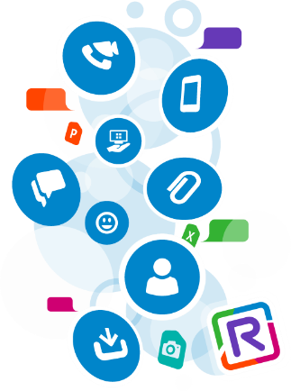
RAINBOW CPAAS: COMMUNICATION PLATFORM AS A SERVICE
DIGITAL TRANSFORMATION
Integrate communications into business processes by connecting people and transforming the way they work.
COMMUNICATION PLATFORM AS A SERVICE
Set of API/SDK accessible as a service (developers don’t care about hosting, scaling and management of the infrastructure) and offering communication and collaboration features (audio, video…)
CPAAS PROVIDER
Company exposing a communication platform as a service focused to help developers integrating communication and collaboration features to their application for transforming their business experiences.
Improve the connected customer experience
Increase employee efficiency
Accelerate decision making
Insure product stickiness

Slide 5



BY USING GAME-CHANGING TECHNOLOGY AT THE CORE OF BUSINESS PROCESSES
2) RE-IMAGINE YOUR PROCESSES
1) RE-IMAGINE YOUR TOOLS
Connect any web site
Audio & Video communication
IM and File Sharing
Availability
Data-Analytics
?
Connect any server
Bot IA relay
Administrative & Provisionning
4) RE-IMAGING YOUR USAGE
3) RE-IMAGINE YOUR ECOSYSTEM
Connect any mobile
Geolocalization & Tracking
Speech Recognition
Connect any IOT device
Scenarios based
Monitor and send alarms

Slide 6


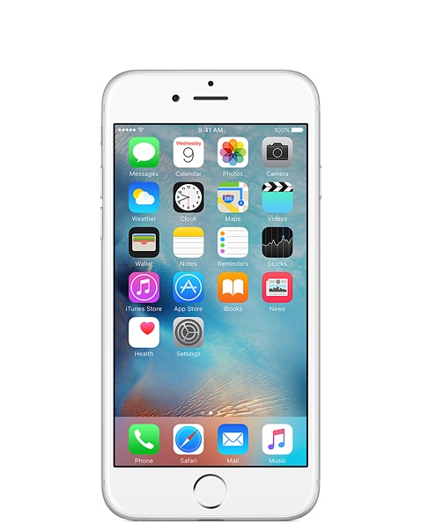

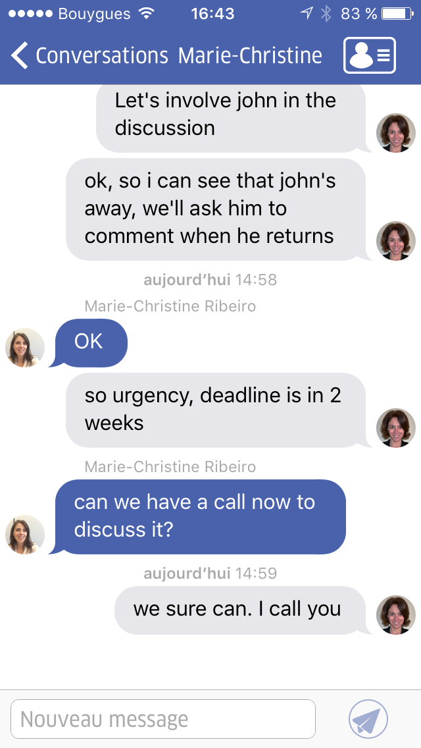

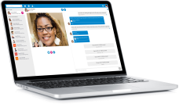


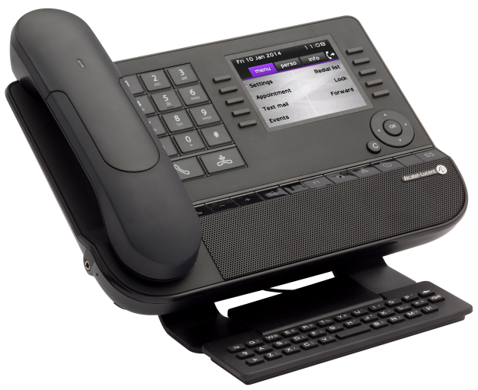


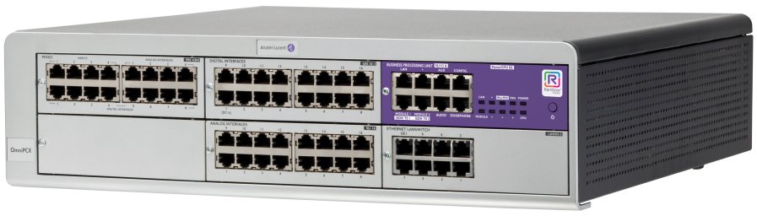




RAINBOW: THE GAME-CHANGING PLATFORM
IDENTITIES
RELATIONS
SERVICES
Rainbow App
Customers and Employees
RELATIONSHIP MACHINE
PBX & Terminals
Internet of Things
Third party APP’s

Slide 7

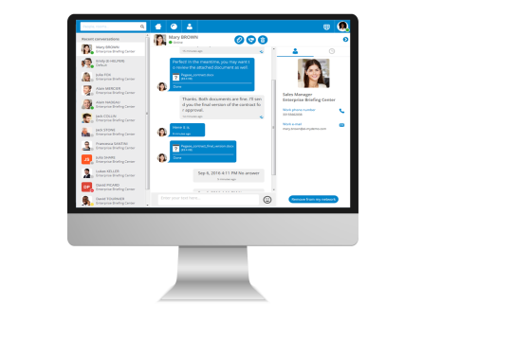
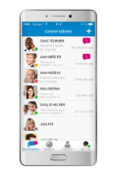
RAINBOW AT THE CORE OF THE OUR CPAAS PLATFORM
IoT
CONTEXTUAL
EXCHANGE
ASSETS
CENSORS
IN APPS
BOTS
CPaaS
Collaboration functions
Messaging services
Community management
Speech recognition – transcription
Authentication
Voice & Video
Recording, Storage
Notification and alerts
APIs

Slide 8

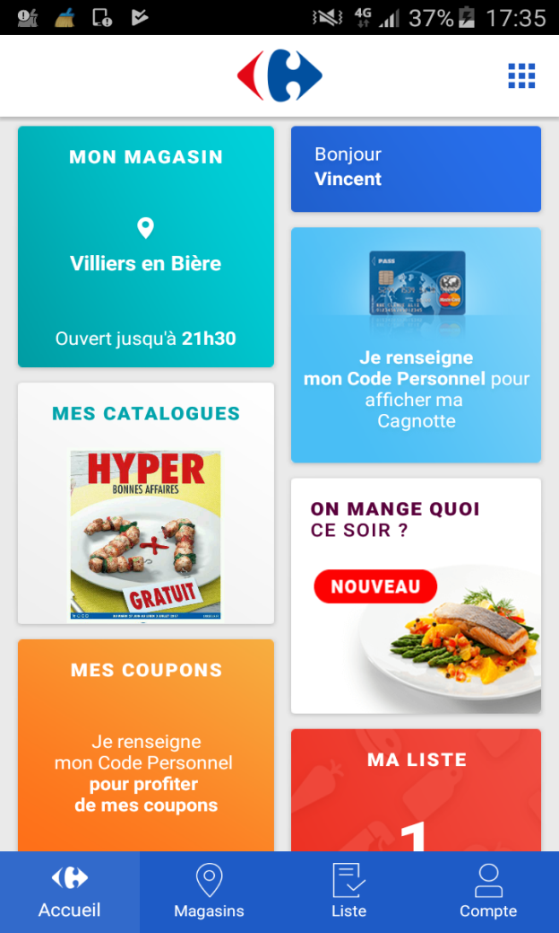

RAINBOW API HUB: BUILD THE BRIDGE FOR THE DEVELOPERS AND MORE
ISV
ENGAGED DEVELOPERS
AMBASSADORS
DEVELOPERS
RAINBOW
CUSTOMERS
Insure product stickiness
Improve the connected customer experience
Increase employee efficiency
Accelerate decision making

Slide 9


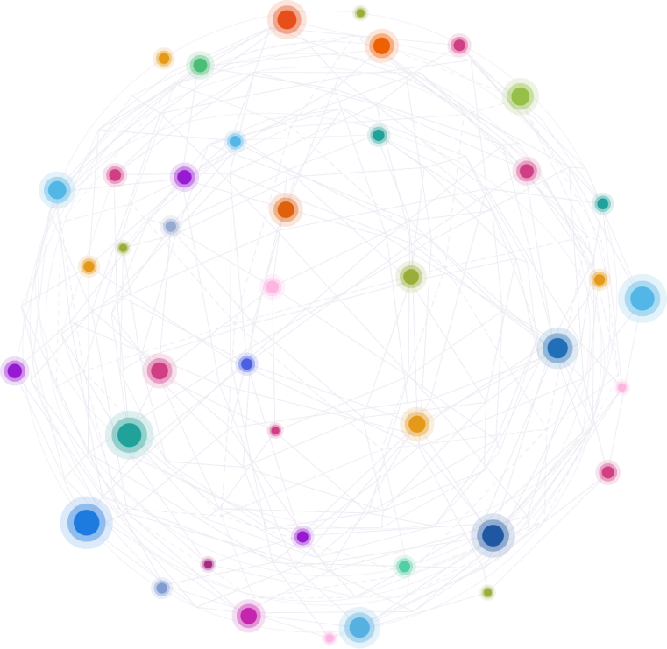
WELCOME TO THE RAINBOW DEVELOPER’S JOURNEY
GROW YOUR APP
Follow your API usage and fees
Analyze your application
5
1
REGISTER A DEVELOPER ACCOUNT
Ask for an account
Discover prerequisites
Subscribe to our newsletter
Reimagine
The developer’s journey
DEPLOY IT
Send a deployment request
Access to Rainbow « Live » Platform
Switch to SDK ESR version
4
2
DISCOVER POSSIBILITIES
Understand Rainbow concepts
Access the documentation,
Download posters and samples
CONNECT YOUR APP
Register an application
Integrate our SDKs, API and keys
Access to the Developer Sandboxed Platform
3

Slide 10
1
REGISTER A DEVELOPER ACCOUNT
1
REGISTER
ASK AN ACCOUNT
DISCOVER POSSIBILITIES
LEVEL 1 OF ENGAGEMENT
Free
SDK Browser & Server
Newsletter
From user to developer
SDK IOS & Android
Social Network
REST APIs

Slide 11

1
DISCOVER SDK & APIS
FOR END CUSTOMER APPLICATIONS
FOR PROVISIONNING AND MANAGEMENT
SDK NODE
SDK WEB
REST API
RAINBOW CLI
SDK ANDROID
SDK IOS

Slide 12
1
PRE-REQUISITES
BUILD END-CUSTOMERS APPLICATIONS |  |  |  |  | OPERATE WITH RAINBOW
SKILLS | SDK FOR WEB | SDK FOR NODE.JS | SDK FOR ANDROID | SDK FOR IOS | REST API
DEVELOPER | Front-End Web Application | Back-End Application IOT | Native Android Application | Native IOS Application | Provisionning and Administrative
DEVELOPMENT | Front-End Web development Skills | Back-End Node.JS development Skills | Android Development Skills | IOS Development Skills | REST API Skills
TECHNICAL | JavaScript HTML 5 CSS 3 Angular (samples) | JavaScript | Java Android | Objective C | -
ENVIRONMENT | Visual Studio Code or equivalent + A Web server | Visual Studio Code or equivalent | Android Studio + Android device(s) | Xcode + IOS device(s) | Depending on technology used

Slide 13
1
BECOME A DEVELOPER
Sign-up
Ask an account
Users
Rainbow Users
Rainbow Developers
Visitors

Slide 14
2
DISCOVER POSSIBILITIES
2
DISCOVER
DISCOVER LEVEL OF SERVICE
DOCUMENTATION
LEVEL 2 OF ENGAGEMENT
SDK and API Level of Services
Getting Started
Technical forums and blogs
Starter Kits and samples
Guides
Support & Live Support
Posters

Slide 15
2
SDK AND API LEVEL OF SERVICES
BUILD END-CUSTOMERS APPLICATIONS |  |  |  | OPERATE WITH RAINBOW
SDK FOR WEB | SDK FOR NODE.JS | SDK FOR ANDROID | SDK FOR IOS | REST API
Front-End Web Application | Back-End Application IOT | Native Android Application | Native IOS Application | Provisionning and Administrative
Any Browsers (Stable or LTS) Any OS | Starting Node.JS LTS version Any Node.JS supported OS | Any Device Starting Android 4.4 | Any Device Starting IOS 9 | Any
Login Contacts / Search Presence Conversation Bubbles WebRTC Audio & Video WebRTC Sharing ^{NEW} FileSharing Capabilities Telephony | Login Contacts / Search Presence Conversation Bubbles Proxy Auto-Reconnect ^{NEW} Users and Guests ^{NEW} | Login Contacts / Search Presence Conversation Bubbles ^{NEW} WebRTC ^{NEW} FilesSharing ^{NEW} Capabilities | Login Contacts / Search Presence Conversation Bubbles ^{NEW} WebRTC ^{NEW} FilesSharing ^{NEW} Capabilities | Users Users Profiles Companies Sites Organizations Systems Phones Offers Subscriptions Quotations Invoices
> 150 API & EVENTS | > 50 API & EVENTS | > 100 API & EVENTS | > 100 API & EVENTS | > 100 API
AVAILABLE | AVAILABLE | AVAILABLE | LIMITED (OCT’17) AVAILABLE EOY’17 | AVAILABLE

Slide 16
2
PACKAGING, SOURCE CODE AND STARTER KITS
SDK
SOURCE CODE
SAMPLE APP AND STARTER KITS
SDK NODE
SDK WEB
SDK NODE
SDK WEB JQUERY
SDK WEB REACT
SDK WEB ANGULAR 4
Starting 1.29
SDK ANDROID
SDK IOS
SDK ANDROID
ANDROID SAMPLES
SDK WEB
Gradle
4x samples
4x samples
RAINBOW CLI
RAINBOW CLI

Slide 17
2
FOLLOW-US AND HELP-US GROWING
RAINBOW CPAAS PROJECTS ON GITHUB
https://github.com/Rainbow-CPaaS/
RAINBOW SDK ON NPM https://www.npmjs.com/

Slide 18
2
DOCUMENTATION
BUILD END-CUSTOMERS APPLICATIONS |  |  |  | OPERATE WITH RAINBOW
SDK FOR WEB | SDK FOR NODE.JS | SDK FOR ANDROID | SDK FOR IOS | REST API
Front-End Web Application | Back-End Application IOT | Native Android Application | Native IOS Application | Provisionning and Administrative
Getting Started What’s New | Getting Started What’s New | Getting Started What’s New | Getting Started What’s New | Getting Started ^{NEW}
API Documentation | API Documentation | API Documentation | API Documentation | API Documentation
13 Guides Setup configuration file Connecting to Rainbow … Supporting non-angular app | 7 Guides Connecting to Rainbow ^{NEW} Answering to Chat messages ^{NEW} Debugging ^{NEW} Proxy ^{NEW} Managing users ^{NEW} Managing Bubbles ^{NEW} | 8 Guides Connecting to Rainbow ^{NEW} Retrieving contacts ^{NEW} Chatting with Rainbow users ^{NEW} Make audio and video call ^{NEW} … Share files with users ^{NEW} | Guides | 2 Guides Connecting to Rainbow ^{NEW}
4 Samples with sources
PDF API Posters PDF Models Posters | - | - | - | -
IN PROGRESS
+ 6 global guides (HUB)

Slide 19
2
DOCUMENTATION MATTERS
Documentation is the part the most expected by developers
IMPORTANT FACTORS (RATED 1-4)
Complete and accurate documentation | 3.6
Service availability/uptime | 3.55
Service responsiveness/performance | 3.5
A or documentation change log | 3.35
Active developer community | 3.1
Customer service responsiveness | 2.9
Price | 2.85
Language-specific SDKs / Helper libraries | 2.75
Service status dashboard | 2.6
API console or explorer | 2.55
User forums | 2.45
Service-specific blog | 2.1
Service-specific Twitter account | 1.85
COMPARISON OF EFFORT
5K
8K
SDK NODE.JS Lines of code
GUIDES Lines of doc
The State of API Documentation: 2017 edition
36 guides already available

Slide 20
3
CONNECT YOUR APP
3
CONNECT
MASTERING RAINBOW
REGISTER AN APPLICATION
DEVELOPER SANDBOX PLATFORM
Learning key concepts
Create and describe it
Free of Charge
Get the application key
Sandboxed from Rainbow
Admin account + Company

Slide 21
3
EXPOSING RAINBOW CONCEPTS
SYSTEM
ENTITY
MEMBERSHIP
ID
GUEST
IDENTITY
ID
What is the limit of my playground ?
IDENTITY
DEVICE
Who am I ?
X
IDENTITY
ORG
PRIVATE
ID
ID
IDENTITY
PRIVATE
COMPANY
IDENTITY
PRIVACY RULES
USER
Name
PUBLIC
IDENTITY
Login
ID
PUBLIC
COMPANY
IDENTITY
THING
COMPANY
SITE
ID
ID
PUBLIC
4 PILLARS
USER
AVAILABILITY
CALENDAR
PHONE
What can I do ?
ACTIVITY
…
USER
USER
PRIVILEGED
How I keep in touch with users ?
CPAAS
Profile
ENTERPRISE
`network`
LONG TERM
USER
Role
USER
Interactions logs
IM
USER
USER
P2P Video
USER
SFU
ESSENTIAL
SPONTANEOUS
USER
USER
call
CPAAS
BUSINESS
GUEST
ADMIN
RELATION
RIGHT

Slide 22
3
DEVELOPERS SANDBOXED PLATFORM
DEVELOPERS SANDBOXED
PLATFORM
RAINBOW
PLATFORM
Limited to developers
End-Customers Rainbow account
Limited to basic Rainbow services
Full Rainbow services
Free of Charge
Fees depending API usage
1 developer account with company admin right
1 private company
Others test accounts can be created in that company
Special configuration on demand

Slide 23

3
SECURED OPENNESS
Access granted to identified application only
(Application ID / Secret key)
APP
Token
Register
RAINBOW
PLATFORM
/!\ Token will be mandatory starting January’18

Slide 24
4
DEPLOY YOUR APPLICATION
4
DEPLOY
ALE VALIDATION
ACCESS RAINBOW OFFICIAL
SDK ESR
Terms of Use
Whole Rainbow services
Extended Support Release
Payment method
Application Lifecycle
ALE Support

Slide 25
4
APPLICATION LIFECYCLE
CONTROL
API MISUSE / ABUSE
APP
ENV: IN-DEPLOYMENT
ALE
VALIDATION
APP
ENV: DEPLOYED
STATE: BLOCKED
DEVELOPER
ALE
ASK TO DEPLOY
APP
APP
APP
APP
APP
ENV: SANDBOX
ENV: DEPLOYED
STATE: NEW
ENV: DEPLOYED
STATE: ACTIVE
ENV: DEPLOYED
STATE: STOPPED
ENV: DEPLOYED
STATE: DELETED
First connection
DEVELOPERS SANDBOXED PLATFORM
RAINBOW PLATFORM

Slide 26
4
SDK BETA AND ESR (EXTENDED SUPPORT RELEASE)
RAINBOW VERSION
Rainbow 1.29
Rainbow 1.30
Rainbow 1.31
Rainbow 1.32
Rainbow 1.33
Rainbow 1.34
Rainbow 1.35
Rainbow 1.36
Rainbow 1.37
Rainbow 1.38
SDK BETA VERSION
NEW FEATURES
SDK 1.29
SDK 1.30
SDK 1.31
SDK 1.32
SDK 1.33
SDK 1.34
SDK 1.35
SDK 1.36
SDK 1.37
SDK 1.38
SDK ESR VERSION
STABILITY BUG FIXES
SDK ESR 1.29.0
SDK ESR 1.29.1
SDK ESR 1.29.2
SDK ESR 1.29.3
SDK ESR 1.29.4
SDK ESR 1.33.0
SDK ESR 1.33.1
SDK ESR 1.33.2
SDK ESR 1.33.3
SDK ESR 1.33.4
Qualify
SDK ESR 1.37.0
SDK ESR 1.37.1
Qualify

Slide 27
5
ANALYZE AND GROWTH
5
ANALYZE
API USAGE & FEES
ANALYTICS
REFERENCEMENT
API Consumption
Audience
Heroes Hall of Fame
Fees
Usage
Store

Slide 28
5
FEES AND ASSOCIATED PAY PER USE MODELS
BASED ON TECHNICAL KPI
BASED ON BUSINESS KPI
€
PREDICTABILITY
€
PREDICTABILITY
MEASURE PLATFORM USAGE
MEASURE BUSINESS USAGE
APIs
Per App
SECONDS
Per App
GB
Per App
?
Per advisor
Per line
…
API
TRAFIC
BANDWIDTH
# USERS
# ROOMS
?
APPLICATION USAGE
APPLICATION USAGE
STANDALONE DEV / STARTUP
ISV
XXL / STRATEGIC / ALE PARTNERS

Slide 29
ARE YOU READY TO START ?

Slide 30
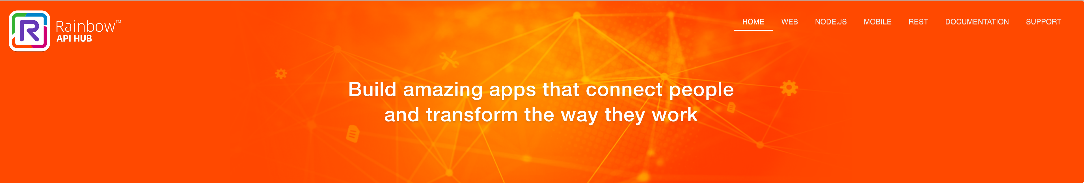
https://hub.openrainbow.com
You are here
1
2
3
4
5
REGISTER
DEV ACCOUNT
AVAILABLE
DISCOVER POSSIBILITIES
AVAILABLE
CONNECT AND DEPLOY YOUR APP
EOF’17
GROW
YOUR APP
Q1’18

Slide 31
DEVELOPERS STARTING POINT
#support #api
Ask Emily for a developer account
or support@openrainbow.com
Access to the Developer Sandboxed Platform
https://web-sandbox.openrainbow.com
Be informed of new features and releases
subscribe to our newsletter
LEARN
EXPERIMENT
BE READY

Slide 32
More than 40 ISV or partners have already started with Rainbow CPAAS

Slide 33


VERTICALIZED DEMOS TO SHOW OPPORTUNITIES
TRANSPORT
EDUCATION
HOSPITALITY
HEALTHCARE
GOVERNMENT
Bot for booking Hotel rooms
Video remote consultation and virtual waiting room
End customer video call with advisor
Bot orders Uber
Student Teacher / Staff relation
Bot retrieves Air France Flight info
Concierge Bot for TUI Boat
Dedicated Platform in progress for « live » demos (with reservation)

Slide 34
#PATTERN: CONNECT USERS TO BOT
Example: Propose a bot that replaces first-level advisor help
BOT WITH AI
IBM WATSON
IBM WATSON
BOT
ASK
ANSWER
ASK
ANSWER
NODE.JS APP
NODE.JS APP
NODE.JS APP
SDK FOR NODE.JS
SDK FOR NODE.JS
SDK FOR NODE.JS
FIND
ASK
ANSWER
FIND
ASK
ANSWER
FIND
ASK
ANSWER
SDK FOR ANDROID
RAINBOW APP
RAINBOW APP
ANDROID APP
NEW USER EXPERIENCE
SIMPLE BOT INTERACTION
AI BOT INTERACTION
CUSTOMIZE USER EXPERIENCE
STEP 1
STEP 2
STEP 3

Slide 35
#PATTERN: CONNECT GUESTS TO ADVISOR
Example: Propose a « I need help » button to visitors of a Web site that connects a visitor to an advisor
GUEST
ADVISOR’S LIST
ADVISOR
CHAT FILESHARING
CREATE
SERVER
ADD GUEST
BUBBLE
ADD AVAILABLE ADVISOR
BUBBLE
SDK FOR NODE.JS
AUDIO VIDEO
CREATE GUEST
GUEST ACCOUNT
CREATE
CHAT FILESHARING
SERVER
CLIENT
NODE.JS APP
SDK FOR NODE.JS
SDK FOR WEB
REQUEST HELP
GUEST ACCOUNT
FIND ADVISOR
CREATE BUBBLE
PUT ADVISOR AND GUEST IN BUBBLE
LOGIN GUEST
CHAT FILESHARING
AUDIO VIDEO
WEB SITE
NODE.JS APP
WEB SITE
GUEST USER REGISTRATION
CREATE RELATIONSHIP
ADVISOR HELPS VISITOR
STEP 1
STEP 2
STEP 3

Slide 36
#PATTERN: PRESENCE BASED MONITORING
Example: Propose a bot that monitors IOT devices and alerts one or several people in case of failure detection
BOT’S NETWORK
BUBBLE
SUPERVISOR
RAINBOW APP
SEND MSG
ADMIN
BOT
BOT
NOTIFICATION
BOT
SAME IDENTITY
SDK FOR WEB
SDK FOR NODE.JS
SDK FOR NODE.JS
RAINBOW APP
SDK FOR NODE.JS
OTHER SUPERVISORS
WEB SITE
NODE.JS APP
SDK FOR NODE.JS
NODE.JS APP
ONLINE
OFFLINE
START & SUBSCRIBE
MANUAL ACCEPT
RAINBOW
RAINBOW
ONLINE
OFFLINE
IOT
IOT
IOT
SDK FOR NODE.JS
SDK FOR NODE.JS
SDK FOR NODE.JS
NODE.JS APP
NODE.JS APP
NODE.JS APP
IOT REGISTRATION
IOT MONITORING
IOT FAILURE
STEP 1
STEP 2
STEP 3

Slide 37
#PATTERN: URL BASED P2P COMMUNICATION
Example: Audio/Video communication between 2 users based on URL
GUEST
SDK FOR WEB
RAINBOW
RAINBOW
WEB SITE
BOT
BOT
SDK FOR NODE.JS
SDK FOR NODE.JS
RAINBOW
AUDIO VIDEO
NODE.JS APP
NODE.JS APP
CREATE CONVERSATION WITH GUESTID + CALL
CONNECT
CONNECT
ASK GUEST ACCOUNT
ASK GUEST ACCOUNT
GUEST
GUEST
GUEST
SDK FOR WEB
SDK FOR WEB
SDK FOR WEB
URL/GUESTID
WEB SITE
WEB SITE
URL/GUESTID
WEB SITE
GUEST 1 CONNECT TO RAINBOW
GUEST 2 USES URL
GUEST 2 CALLS GUEST 1
STEP 1
STEP 2
STEP 3

Slide 38
#PATTERN: CATEGORIZE USERS
AVAILABLE EOY’17
Example: Propose a bot that asks users for feedbacks, categorizes answers and allow an advisor to recontact them
BOT’S GROUPS
BOT GROUPS
HAPPY USERS
PICK USER
ADD USER TO GROUP
UNSATISFIED USERS
UNSATISFIED USERS
ADVISOR
BOT
SAME IDENTITY
DON’T ANSWER USERS
SDK FOR WEB
SDK FOR NODE.JS
BOT
WEB SITE
NODE.JS APP
RAINBOW
NODE.JS APP
CHAT AUDIO-VIDEO
SDK FOR NODE.JS
ADD USER TO GROUP
RAINBOW
BOT
DISCUSS
ASK FEEDBACK
ANSWER
CHAT AUDIO-VIDEO
SDK FOR NODE.JS
RAINBOW APP
NODE.JS APP
RAINBOW APP
ASK USER FOR FEEDBACK
CATEGORIZE USERS
RECONTACT USER
STEP 1
STEP 2
STEP 3

Slide 39
#PATTERN: MASS-MESSAGE BROADCASTING
AVAILABLE EOY’17
Example: Broadcast message to large group of subscribers
BOT CHANNELS
BOT OR USER CHANNELS
ADD USER TO CHANNEL
#SALES
#SALES
SAME IDENTITY
#RD
USER SUBSCRIBE TO VISIBLE CHANNEL FROM BOT OR USER
#RD
SDK FOR WEB
SDK FOR NODE.JS
#BOARD
#BOARD
WEB SITE
NODE.JS APP
SEND MESSAGE TO CHANNEL
BOT
RAINBOW
NODE.JS APP
USER SUBSCRIBE TO A VISIBLE CHANNEL FROM BOT OR USER
RAINBOW
SDK FOR NODE.JS
BROADCAST MESSAGE TO SUBSCRIBERS
DISCUSS
ASK TO SUBSCRIBE
ANSWER
SDK FOR WEB
RAINBOW APP
RAINBOW APP
RAINBOW APP
WEB SITE
RAINBOW APP
RAINBOW APP
USING PRIVATE CHANNEL
USING PUBLIC CHANNEL
USER OR BOT PUBLISHES A MESSAGE
STEP 1
ALTERNATIVE STEP 1
STEP 2

Slide 40
#PATTERN: REASON CALL
AVAILABLE EOY’17
Example: Inform the recipient about the reason of you call
<INCOMINGCALL REASON=‘TheReason’ />
SDK FOR WEB
<INCOMINGCALL REASON=‘TheReason’ />
SDK FOR WEB
WEB SITE
WEB SITE
RAINBOW
RAINBOW
AUDIO VIDEO
CALL
PBX
MAKECALL (REASON=‘TheReason’)
MAKECALLPBX (REASON=‘TheReason’)
USER
USER
SDK FOR WEB
SDK FOR WEB
WEB SITE
WEB SITE
USING MEDIA-TO-MEDIA
USING 3PCC CALL
STEP 1
STEP 2

Slide 41
#PATTERN: PROXY-BOT + CUSTOM MESSAGE
AVAILABLE BEG’18
Example: Availability sharing between student and teachers without being in touch
BOT GROUPS
BOT NETWORK
TEACHERS FOR CLASS C12345
CONTACT ID=‘570e12832d‘
…
AVAILABILITY
…
BOT
BOT
CUSTOM-DATA
CLASS: « C12345 »
NODE.JS APP
NODE.JS APP
SDK FOR NODE.JS
SDK FOR NODE.JS
CALENDAR
ADD STUDENT TO BUBBLE
<SDK-CUSTOM TYPE=‘TEACHERS_ LIST’ CLASS=C12345 />
<SDK-CUSTOM TYPE=‘AVAILABILITY’ TEACHERID=‘570e12832d‘ />
BOT
STUDENT
STUDENT
NODE.JS APP
SDK FOR WEB
SDK FOR WEB
SDK FOR NODE.JS
WEB SITE
WEB SITE
ADD STUDENT TO HIS CLASS
GET LIST OF TEACHERS FOR CLASS
GET AVAILABILITY OF TEACHERS
STEP 1
STEP 2
STEP 3

Slide 42
API & SDK ROADMAP (SUBJECT TO CHANGE)
2017
2018
Q3
Q4
API
AttachedData Guests
SFU
WebHook Groups
Pub/Sub Mass
Custom Msg
PGI Online Mode
SDK
SDK Android REST API
SDK IOS
React Native bridge
SDK Bot
HUB
Beta
Documentation
Sandbox
Applications
Deployment
API Usage Payment method
Analytics Private applications
COMMUNITY
Newsletters
Tech forum
Tech blog
Dev events
Support
Live Support
Twitter

Slide 43
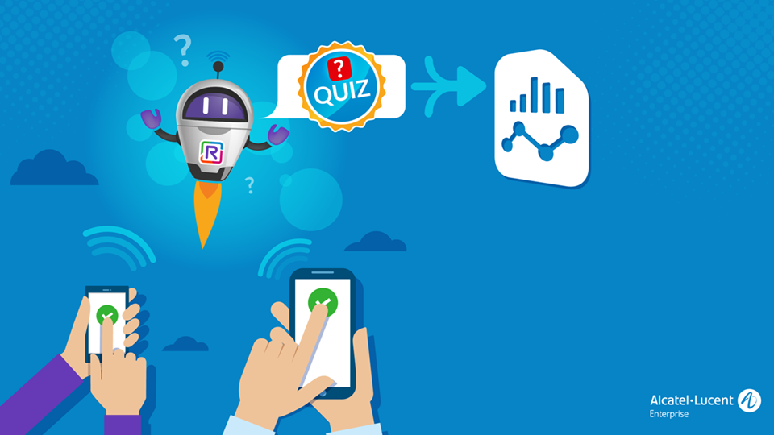

Slide 44
THANK YOU!
GOODIES
SIMPLE
RAINBOW
SDK
RELIABLE
ALE
FORUM
GAME-CHANGER
GREAT SUPPORT
FILE-SHARING
SNIPPETS
AUTONOMOUS
GUIDES
LONG TERM SUPPORT
VOICE & VIDEO
API HEATH CHECK
DIGITAL ENABLER
CHEAP
BLOG
FUN
NEWSLETTERS
CONTACTS
POSTERS
REST API
HUB
CONFERENCE
GROUPCHAT
REAL-TIME
CHAT
BOT
CLI
DOCUMENTATION
SAMPLES
SECURE
WEBRTC
EASY TO START
COMPLETE
SANDBOX
SFU
EVENTS
SAVE TIME
API USAGE
TURN

